Slide 1
Fraudulent Risk Prediction: Machine Learning Assisting Audit Planning
Shuang Zhang

Slide 2
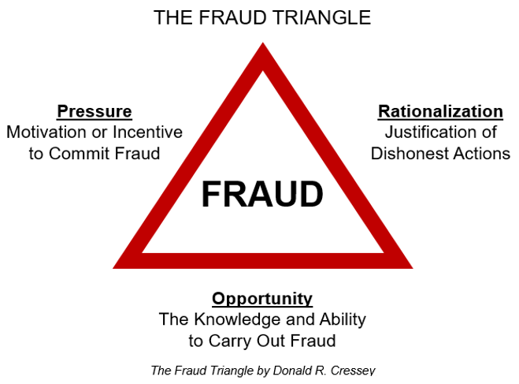
Fraud detection in audit planning

Slide 3
Stakeholders
Auditor: determine the nature, timing and extent of the audit work
The users of the audit report:
Current shareholders
Future shareholders
Bankers and creditors
Management of company
Employee
Government
Wider public

Slide 4
Dataset and target variables
Dataset: Present and historical risk factors of 777 companies from 14 sectors
Source: Comptroller and Auditor General (CAG) of India
Supervised learning
Target | Description | Type
Score | Total risk score obtained from analytical procedure (ARS score) | Regression
Risk | Fraudulent risk class: 1 = "fraud" and 0 = "no-fraud" | Classification
Score/ Risk | 2.0 | 2.2 | 2.4 | 2.6 | 2.8 | 3.0 | 3.2 | 3.4 | 3.6 | 3.8 | 4.0 | 4.2 | 4.4 | 4.6 | 4.8 | 5.0 | 5.2
0 | 290 | 0 | 0 | 0 | 0 | 0 | 0 | 0 | 0 | 0 | 0 | 0 | 0 | 0 | 0 | 0 | 0
1 | 0 | 97 | 79 | 51 | 20 | 19 | 26 | 19 | 30 | 27 | 36 | 30 | 24 | 9 | 13 | 2 | 4

Slide 5
Features
Risk Factor | Description
Para A Value | Discrepancy found in the planned-expenditure of inspection and summary report A in Rs (in crore)
Para B Value | Discrepancy found in the unplanned-expenditure of inspection and summary report B in Rs (in crore)
Total | Total amount of discrepancy found in other reports Rs (in crore)
Numbers | Historical discrepancy score
Money Value | Amount of money involved in misstatements in the past audits
Sector score | Historical risk score value of the sector to which the company belongs
Loss | Amount of loss the company suffered last year
History | Average historical loss the company suffered in the last 10 years
District score | Historical risk score of the district where the company is located

Slide 6
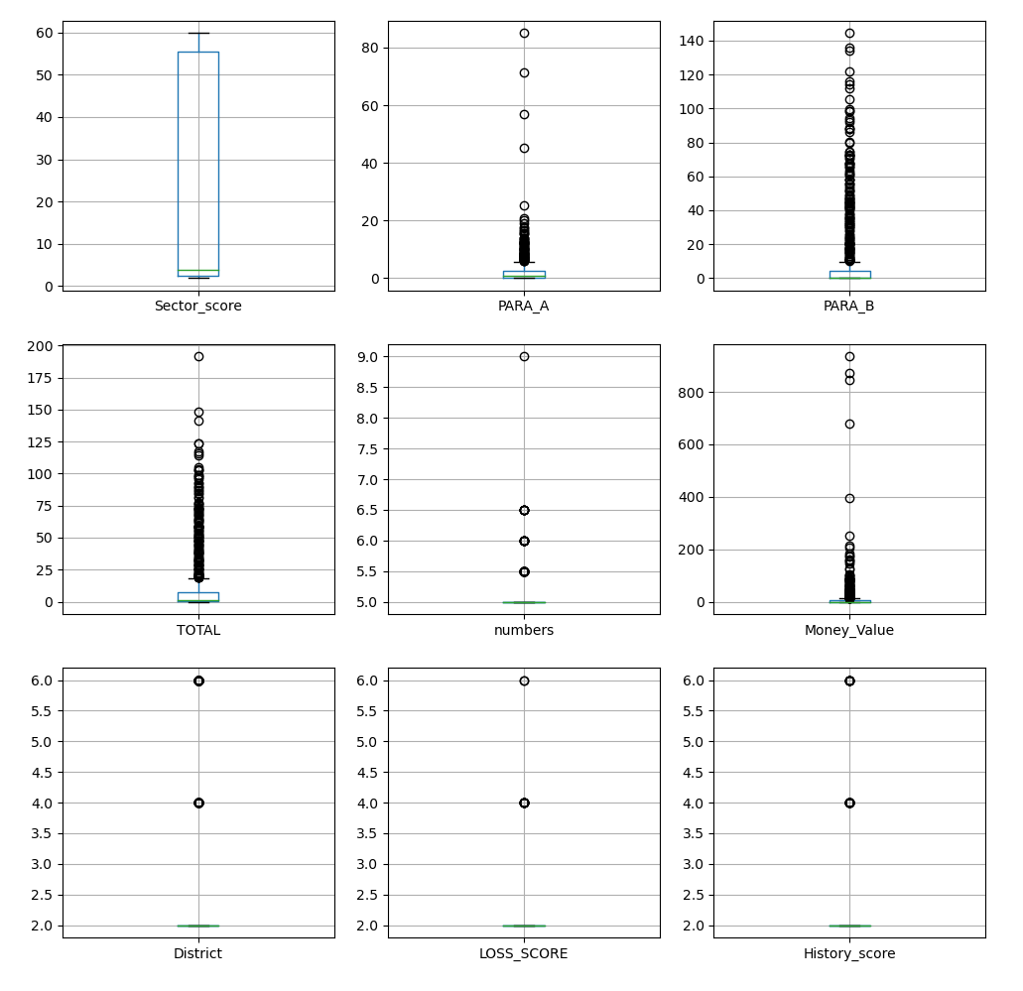
Distribution of features

Slide 7
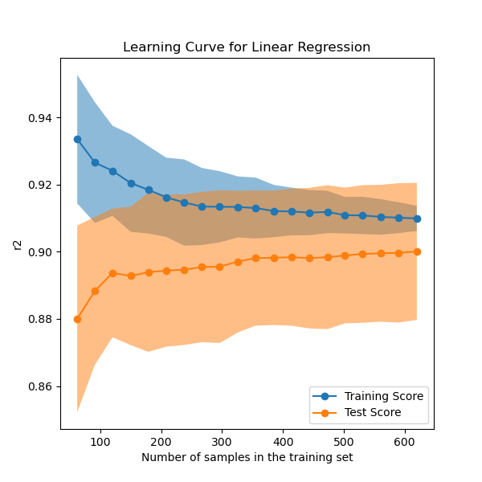
Linear regression
Features: para_a, para_b, numbers, money, sector, district, loss, history
Target: ars
Test set size: 30%
R²: 0.8856
5-Fold cross validation
CV | R² | RMSE
0 | 0.9249 | 0.2211
1 | 0.8915 | 0.2619
2 | 0.8988 | 0.2910
3 | 0.8605 | 0.3258
4 | 0.9082 | 0.2606

Slide 8
Feature selection
Forward feature selection
Lasso regularisation
feature | coefficient
para_b | 0.6736
para_a | 0.3477
numbers | 0.2001
loss | 0.1205
district | 0.1163
money | 0.1115
sector | 0.1018
history | 0.0127
feature | coefficient
para_b | 0.3531
numbers | 0.3329
para_a | 0.2026
money | 0.1173
district | 0.1131
history | 0.0990
loss | 0.0347
sector | 0.0093

Slide 9
Classification models
Features: para_a, para_b, numbers, money, sector, district, loss, history
Target: risk
Test set size: 30%
Grid search for optimal hyperparameters
Model | Description | Optimal parameters
LR | Logistic Regression | C=100
SVC | Support Vector Machine Classifier | C=100, kernel = ‘linear’
NB | Naïve Bayes | var_smoothing=6.5793e-05
KNN | K Nearest Neighbor | n_neighbors=6
DT | Decision tree | criterion='entropy’, max_depth=4

Slide 10


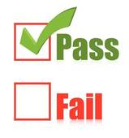

Consequence of errors
False positive (Type I error): Inefficiency -- lead to additional work
False negative (Type II error): Ineffectiveness -- lead to an inappropriate audit opinion

Slide 11
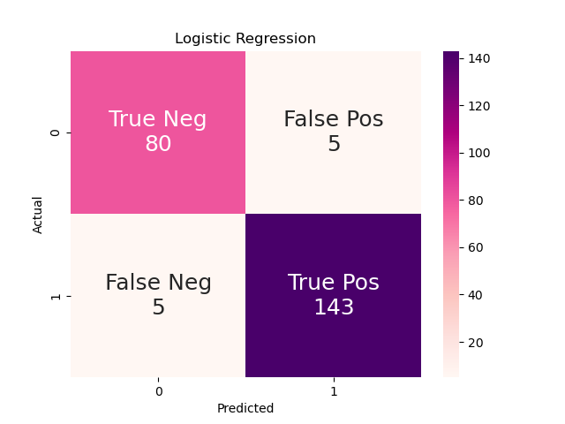




Confusion Matrix

Slide 12
Model Evaluation Metrics
Accuracy = (True Positive + True Negative) / (True Positive + True Negative + False Positive + False Negative)
Precision = True Positive / (True Positive + False Positive)
Recall = True Positive / (True Positive + False Negative)
Specificity = True Negative / (True Negative + False Positive)
F1 Score = Precision × Recall / (Precision + Recall)
AUC = Area under the ROC Curve (receiver operating characteristic curve)

Slide 13
Model Evaluation Scores
Score | LR | SVC | NB | KNN | DT
Accuracy | 0.9571 | 0.9571 | 0.8498 | 0.9571 | 0.9828
Precision | 0.9662 | 0.9662 | 1.0000 | 0.9726 | 0.9800
Recall | 0.9662 | 0.9662 | 0.7635 | 0.9595 | 0.9932
Specificity | 0.9412 | 0.9412 | 1.0000 | 0.9529 | 0.9647
F1 | 0.9662 | 0.9662 | 0.8659 | 0.9660 | 0.9866
AUC | 0.9874 | 0.9888 | 0.9892 | 0.9914 | 0.9840

Slide 14
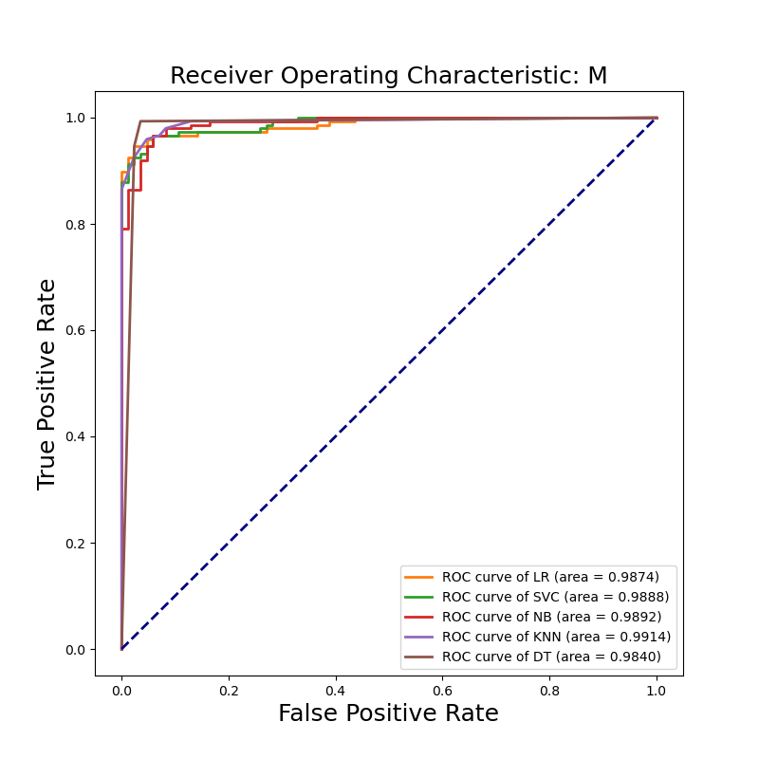
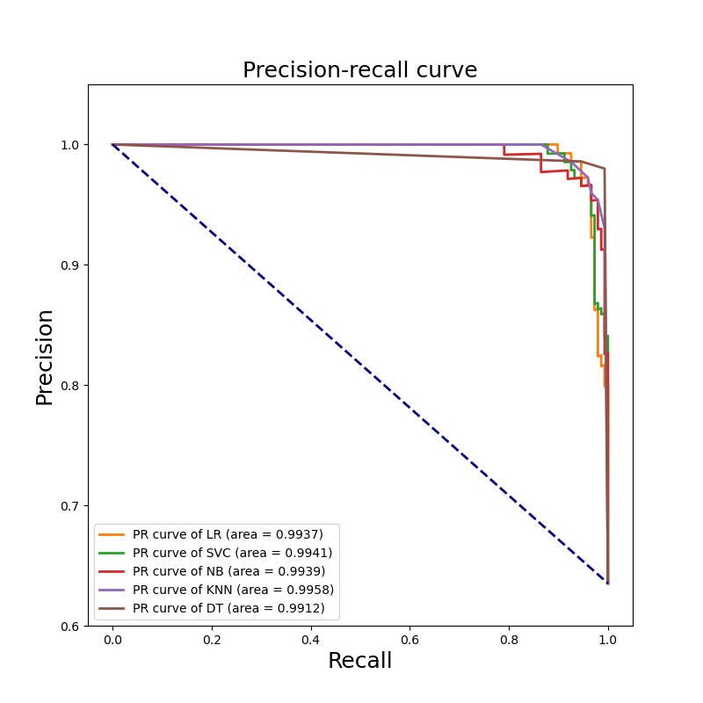
ROC curve and Precision-recall curve

Slide 15
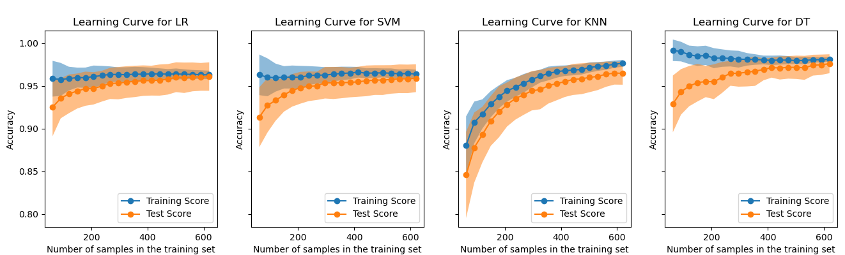
Learning curves

Slide 16
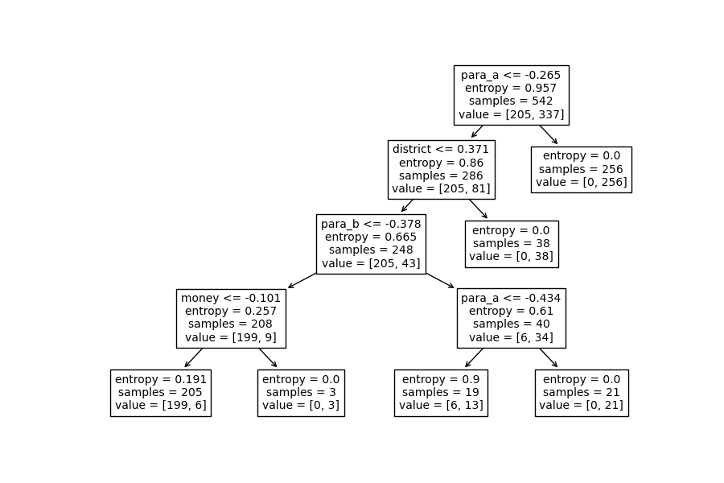
Feature Importance with Decision Tree
Features | Importance
para_a | 0.6055
para_b | 0.1885
district | 0.1749
money | 0.0311
numbers | 0.0000
sector | 0.0000
loss | 0.0000
history | 0.0000

Slide 17
Conclusion
Linear regression could predict the fraud risk score obtained from analytical procedure ('ars’) from risk factors
Decision Tree (DT) is best model to identify fraudulent companies
Overall, both regression and classification machine learning models have low bias and low variance.

